Slide 1



PULSATING ENERGIES
unraveling the Impact of Energy Red Bull on Blood Pressure
Procedur by:
Sakiru Akinpelu

Slide 2




CASE OVERVIEW
The hospital's management is concerned about the growing popularity of energy drinks, particularly Red Bull, and its potential effects on blood pressure levels among individuals.
Recognizing my expertise in data analysis, and entrust me with the task of running a comprehensive analysis on a dataset of 120 volunteers.
The hospital administration wants me to unveil the story hidden within the data, to deliver a
captivating narrative that will educate both staff and patients about the potential risks associated with consuming energy drinks. They seek insights into the impact of Red Bull on blood pressure, with a specific focus on gender disparities, age-related variations, and outlier responses.

Slide 3



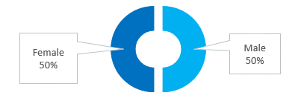


Equal Gender Representation in the Data
120 Total Volunteers
Health is a very important factor of quality of life and it is no news that one of the most popular parameter for measuring health is blood pressure.
But there are numerous things , activities and even emotions that can affect one's blood pressure, the red bull energy drink being one.
In a survey of 120 volunteers equally distributed across both genders, as well as 3 age groups, there blood pressure before and after the consumption of this energy drink was consumed.
Equal Age Group Representation in the Data

Slide 4

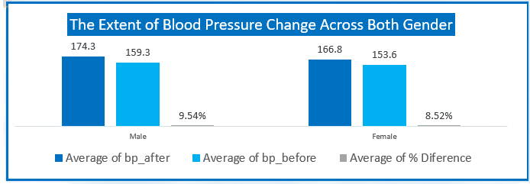

GENDER DISPARITIES
The average blood pressure of male volunteers was initially higher than that of females. However, the male volunteers experienced a significantly greater increase in blood pressure after consuming Red Bull, making them more vulnerable to high blood pressure and potential hypertension.

Slide 5
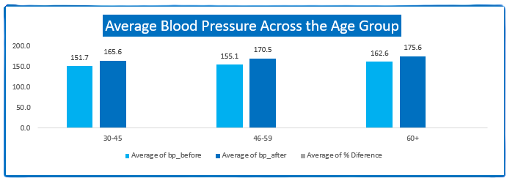
AGE GROUP AND BLOOD PRESSURE
An intriguing pattern emerged when examing blood pressure from an age group perspective. The 60+ age group had a higher average blood pressure but showed the lowest increase after consuming Red Bull. In contrast, the 46-59 age group exhibited the most significant rise in the blood pressure post-consumption.

Slide 6
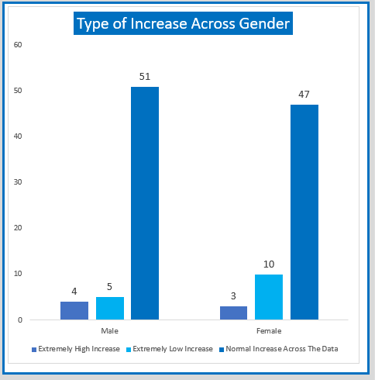
TYPE OF INCREASE ACROSS GENDER
Among the volunteers, a few outliers were observed. Seven individuals experienced an extremely high increase in blood pressure after consuming Red Bull, indicating potential health issues or other unaccounted factors. Conversely, 15 volunteers displayed insignificant changes in blood pressure values, suggesting a milder response.

Slide 7
RECOMMENDATIONS (BASED ON DATA)
1. Awareness and Caution
Given the significant in blood pressure observed, particularly among male volunteers, it is crucial to raise awareness about the potential effects of energy drinks, such as Red Bull, on blood pressure levels. Individual should exercise caution when consuming these beverages, especially, if they have pre-existing cardiovascular concerns. Healthcare providers should also educate their patients about the potential risks and advise moderation or avoidance when necessary.

Slide 8
RECOMMENDATIONS (BASED ON DATA)
2. Further Investigation
The variations observed across gender and age groups, as well as the presence of outliers, indicate the need for further research and investigation. Further studies should explore the underlying factors contributing to the gender disparities, age-related variations, and extreme blood pressure responses observed. This will help in developing a more comprehensive understanding of the complex relationship between energy drinks and blood pressure.

Slide 9
RECOMMENDATIONS (BASED ON DATA)
3. Holistic Health Consideration
While this analysis focused on the effects of Red bull on blood pressure, it is important to approach health holistically. Individuals should consider their overall lifestyle, including diet, exercise, stress levels, and other factors that can influence blood pressure. Encouraging a balanced and healthy lifestyle that includes adequate sleep, regular physical activity, and a nutritious diet can contribute to maintaining optimal blood levels.

